Slide 1
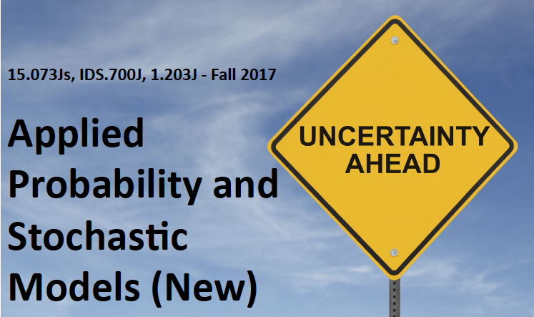

Pedestrian Crossing Problem
September 11, 13, 2017
Richard C. Larson
MIT E17-365 rclarson@mit.edu

Slide 2
Issue of Homework Collaboration
OK to meet in small groups to talk through approaches to Homework problems, but then please do each problem independently and let us know the names of those with whom you collaborated. ☺

Slide 3
Learning Objectives
Problem Framing, Formulation and Solution
  Phenomenon-based problems
Review of Poisson Processes
Begin Pedestrian Crossing Problem
Next time: Introduction to Random Incidence
Reference: Urban Operations Research, Chapter 2, Sec. 2.14 http://web.mit.edu/urban_or_book/www/book/chapter2/2.14.html

Slide 4
Problem Framing, Formulation and Solution

Slide 5

Frame:
"To shape, fashion or form"
"To put together the parts of"
"To enclose in a border'
"To shape, fashion or form"
"To put together the parts of"
"To enclose in a border"
New World Dictionary
How might you frame your approach to Hurricane Irma?
Other framings? Sports? Transportation?

Slide 6
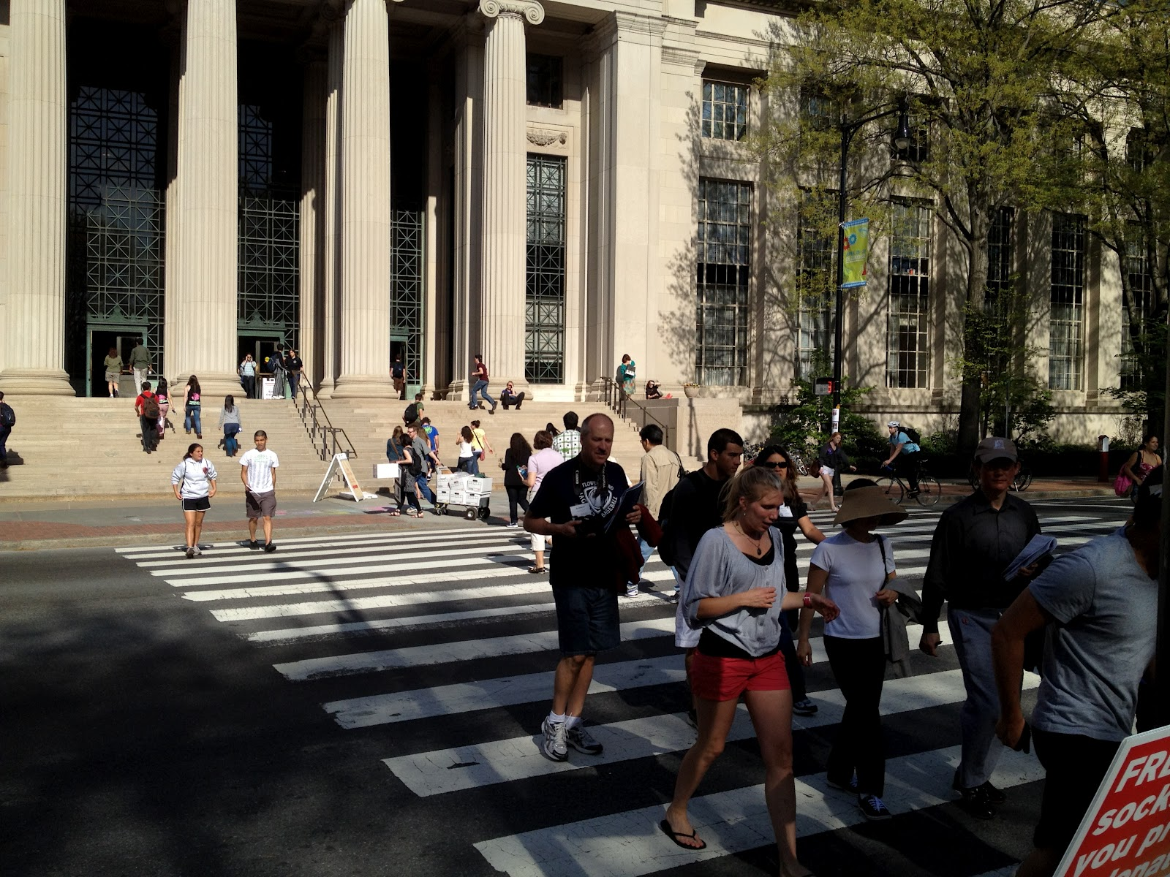

Slide 7
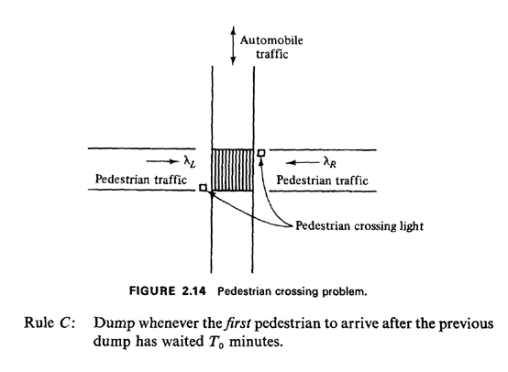
A Rough Model of 77 Massachusetts Avenue

Slide 8
Rule A: Dump Every T Minutes (open loop control)

Slide 9
Rule B: Dump When Pedestrian Count = N_{o}
_{(closed loop control)}

Slide 10
Rule C: Dump Whenever Longest Wait = T_{o} Min.
(again closed loop control)

Slide 11
Two independent
Poisson Processes
A Rough Model of 77 Massachusetts Avenue

Slide 12
= waiting pedestrian
= “queuer”
A Rough Model of 77 Massachusetts Avenue

Slide 13
For each decision rule, determine:
Expected number of pedestrians crossing left to right on any dump
Probability that zero pedestrians cross left to right on any dump
The pdf for time between dumps
Expected time that a randomly arriving customer must wait until crossing
Expected time that a randomly arriving observer, who is not a pedestrian, will wait until the next dump

Slide 14

Today we work out the answers together on the blackboard!
http://www.apaf93.dsl.pipex.com/images/blackboard.jpg

Slide 15
What do we know about
Poisson Processes?
Independent increments. Meaning?
Both pdf’s and pmf’s Examples?
Named after the French mathematician Siméon-Denis Poisson ( 1781–1840)
http://en.wikipedia.org/wiki/Poisson_process
**Generalizations of Poisson Process? (merges, splitting)
**Example of a non-Poisson Process?
**How about MBTA busses on Mass Ave?

Slide 16
Want to Become Really Fit in Applied Probability Modeling?
Requires…
Great Conditioning!

Slide 17
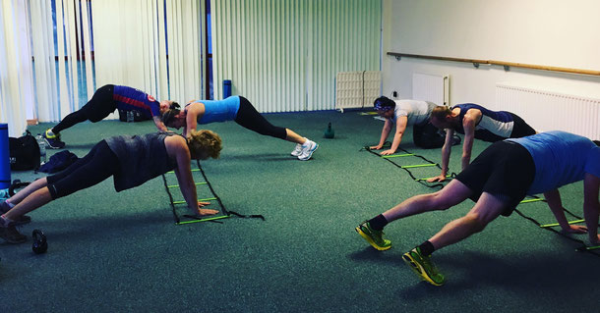
Want to Become Really Fit in Applied Probability Modeling?
Requires…
Great Conditioning!
This?

Slide 18
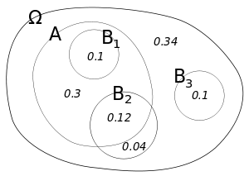
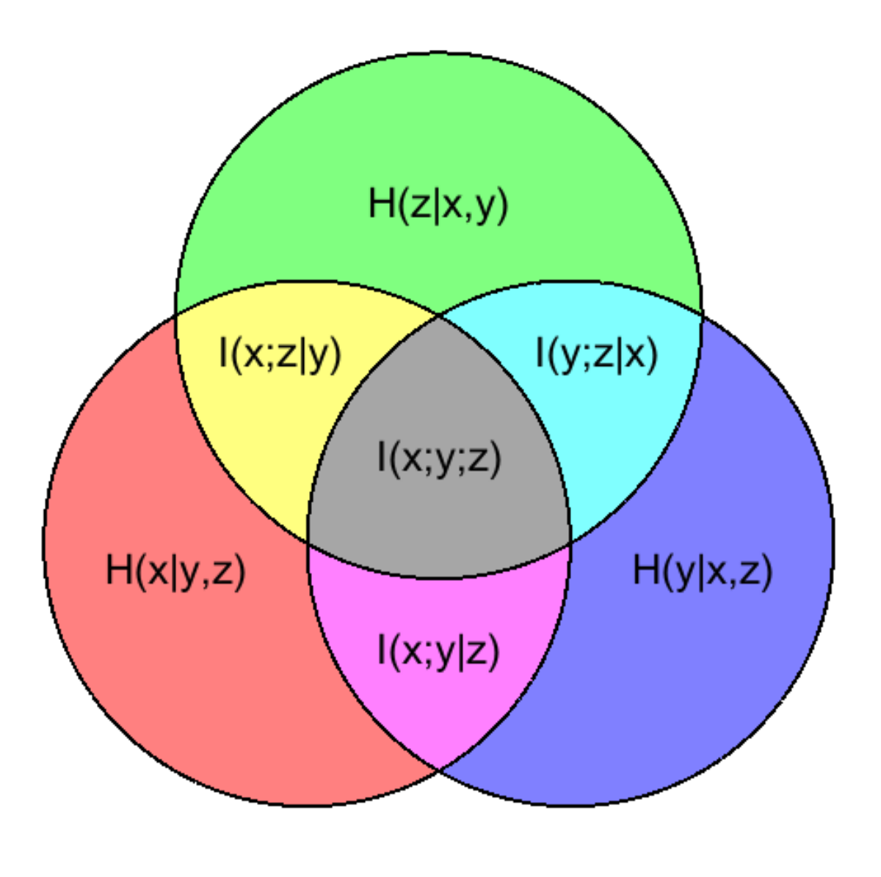
Want to Become Really Fit in Applied Probability Modeling?
Requires…
Great Conditioning!
Maybe, but better this…

Slide 19
1. Expected number of pedestrians crossing left to right on any dump
Fixed time T
Total is N₀
Longest wait is T₀

Slide 20
2. Probability that zero pedestrians cross left to right on any dump
Fixed time T
Total is N₀
Longest wait is T₀

Slide 21
3. The pdf for time between dumps
Fixed time T
Total is N₀
Longest wait is T₀

Slide 22

PDF for time between dumps, Fixed time T
In class, we developed the “unit impulse function”, Also has other names.
This function is zero everywhere except at x=T. The integral of this function from some point less than T to some point greater that T is 1.0.

Slide 23
PDF for time between dumps, Total is N₀
Draw a picture of this, 2 events over disjoint time intervals
0
N₀-1 arrivals here
t
t+dt
1 arrival here

Slide 24
PDF for time between dumps, Total is N₀
Draw a picture of this, 2 events over disjoint time intervals
0
N₀-1 arrivals here
t
t+dt
1 arrival here

Slide 25
PDF for time between dumps, Total is N₀
Draw a picture of this, 2 events over disjoint time intervals
0
N₀-1 arrivals here
t
t+dt
1 arrival here
Probability of one more in (t, t+dt) ??
That’s simply λdt.

Slide 26
PDF for time between dumps, Total is N₀
Draw a picture of this, 2 events over disjoint time intervals
Probability of one more in (t, t+dt)=λdt.
Therefore, we get an Erlang-order N₀ pdf:

Slide 27
PDF for time between dumps, Longest wait is T₀
Look at Erlang Order 1. What do you see?
Yes, negative exponential with mean 1/λ.
Plot this. Now add T₀ to the original random variable. What do you get?

Slide 28
4. Expected time that randomly arriving customer must wait until crossing
Fixed time T
Total is N₀
Longest wait is T₀

Slide 29
Expected time that randomly arriving pedestrian must wait
Rule A. Dump Every T Minutes
How to think about this? You show up.
What is your wait? PDF, Mean?

Slide 30
Expected time that randomly arriving pedestrian must wait
Rule B: Dump when N₀th PED shows up
How to think about this? You show up at a random time. What do you see?

Slide 31
Expected time that randomly arriving pedestrian must wait
Rule C: DUMP T minutes after button pushed
Mean wait: T for button pusher. Others?
Mean wait for others is T/2.
One cycle: Mean # PEDS = 1+λT₀
N cycles: Fraction who are button pushers

Slide 32
Expected time that randomly arriving pedestrian must wait
Rule C: DUMP T minutes after button pushed
N cycles: Fraction who are button pushers
Why?

Slide 33
5. Expected time that a randomly arriving observer, who is not a pedestrian, will wait until next dump
Fixed time T
Total is N₀
Longest wait is T₀

Slide 34
Expected time that randomly arriving observer must wait
Rule A: DUMP every T minutes
Any difference here between an observer and a PED??
NO! ☺

Slide 35
Expected time that randomly arriving observer must wait
Rule B: DUMP when N₀th PED arrives
Is this the same as before? Why or Why not?
Argue that this is correct logic:

Slide 36
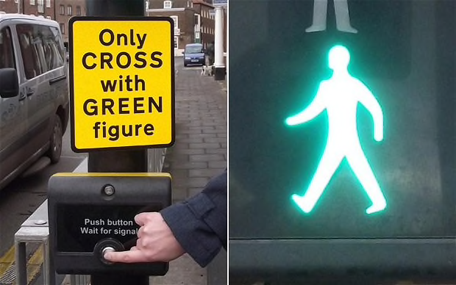
Expected time that randomly arriving observer must wait
Rule C: Button pusher!
Wait until Random Incidence

